Slide 1


Global Climate Change
Week 3 - Radiation and the Greenhouse Effect
Dr Thomas Bannan
Thomas.Bannan@Manchester.ac.uk

Slide 2
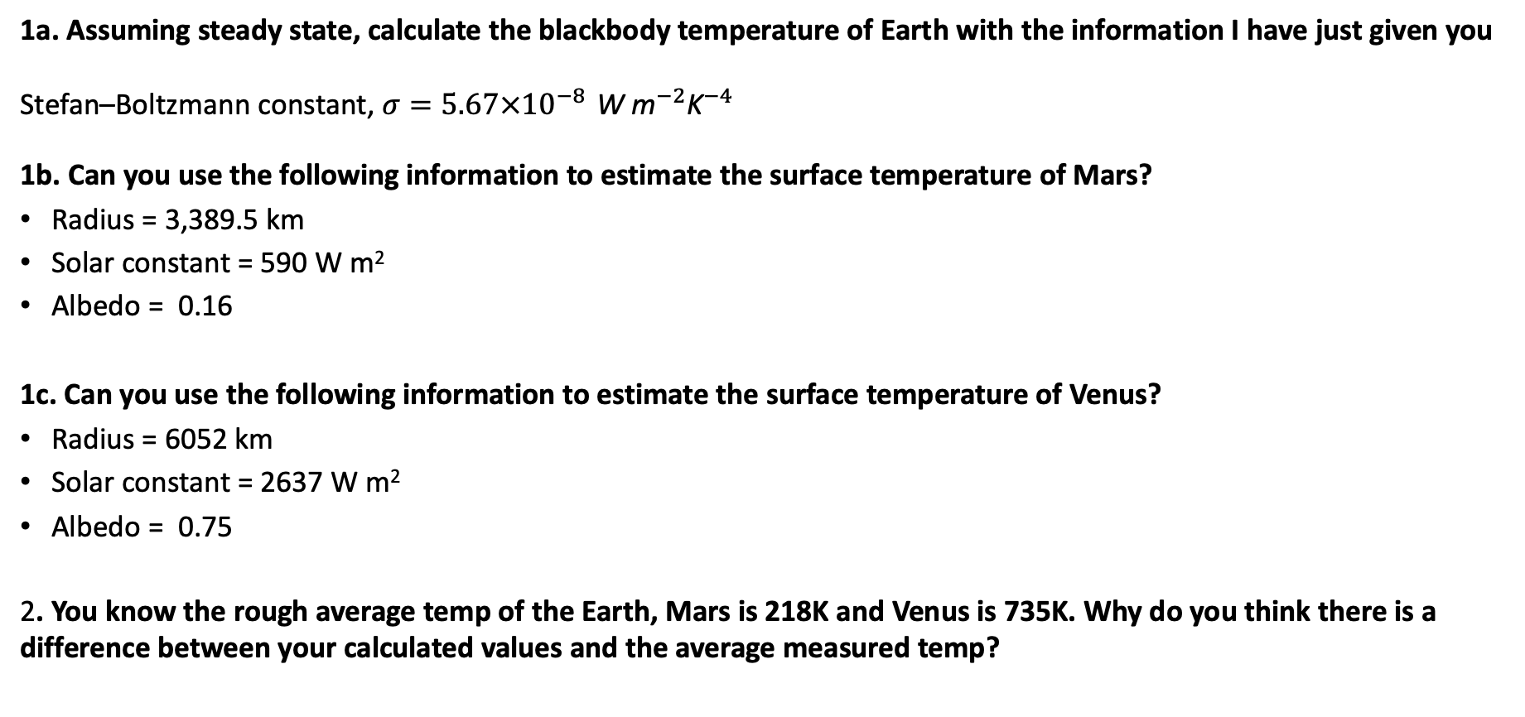
Workshop 1
1a. Assuming steady state, calculate the blackbody temperature of Earth with the information I have just given you
Stefan–Boltzmann constant, $σ=5.67×{10}^{−8 }{\text{W} \text{m}}^{−2}{\text{K}}^{−4}$
1b. Can you use the following information to estimate the surface temperature of Mars?
Radius = 3,389.5 km
Solar constant = 590 W m²
Albedo = 0.16
1c. Can you use the following information to estimate the surface temperature of Venus?
Radius = 6052 km
Solar constant = 2637 W m²
Albedo = 0.75
2. You know the rough average temp of the Earth, Mars is 218K and Venus is 735K. Why do you think there is a difference between your calculated values and the average measured temp?

Slide 3

Q1a. Answer
In steady state the energy entering top of atmosphere = energy leaving the atmosphere
S_{o} x Area (A) x albedo = σT_{E}⁴ 4πr_{e}²
0.7 x 1370 x πr_{e}² = σT_{e}⁴ x 4πr_{e}²
(0.7 x 1370)/ 4σ = T_{e}⁴
T_{e}= [(0.7 x 1370)/ 4σ ]^{1/4} = [(1-a) * S) / (4 σ)]) ^{1/4}
T_{e} = 255K (-18°C) is the equivalent blackbody temperature of the Earth

Slide 4
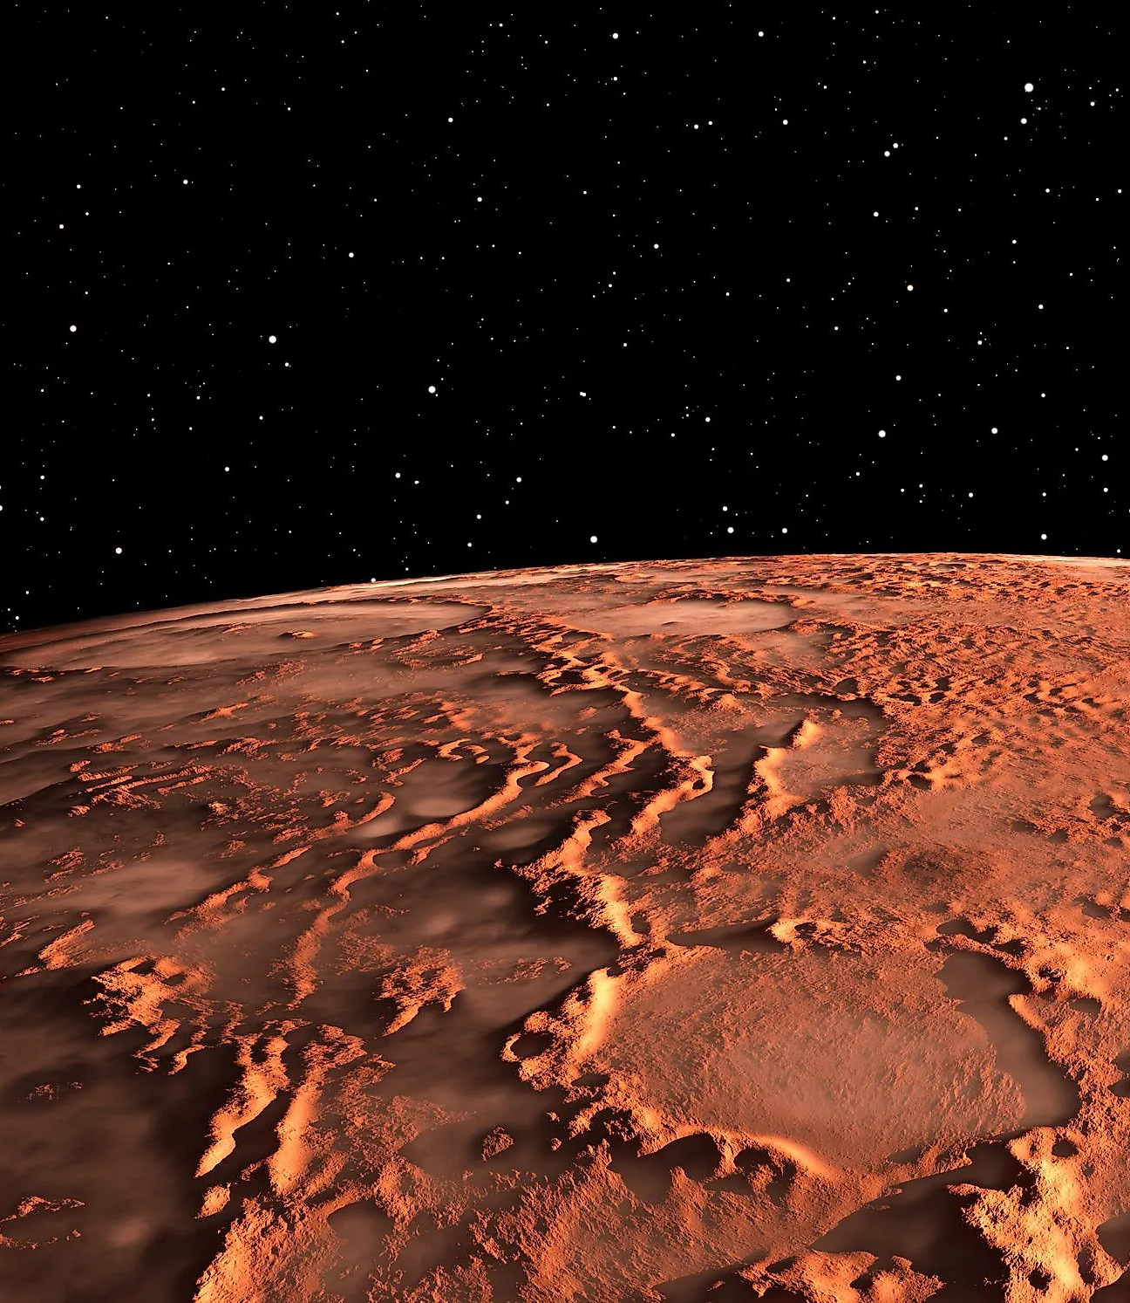
Q1b. Answer
Can you use the following information to estimate the surface temperature of Mars?
Radius = 3,389.5 km
Solar constant = 590 W m²
Albedo = 0.16
S_{o} x Area (A) x albedo = σT_{E}⁴ 4πr_{e}²
T = (((1-albedo) * solar constant) / (4σ))^{1/4}
= ((0.84*590) / (4*5.67*10⁻⁸))^{1/4}
= 216.2 K

Slide 5
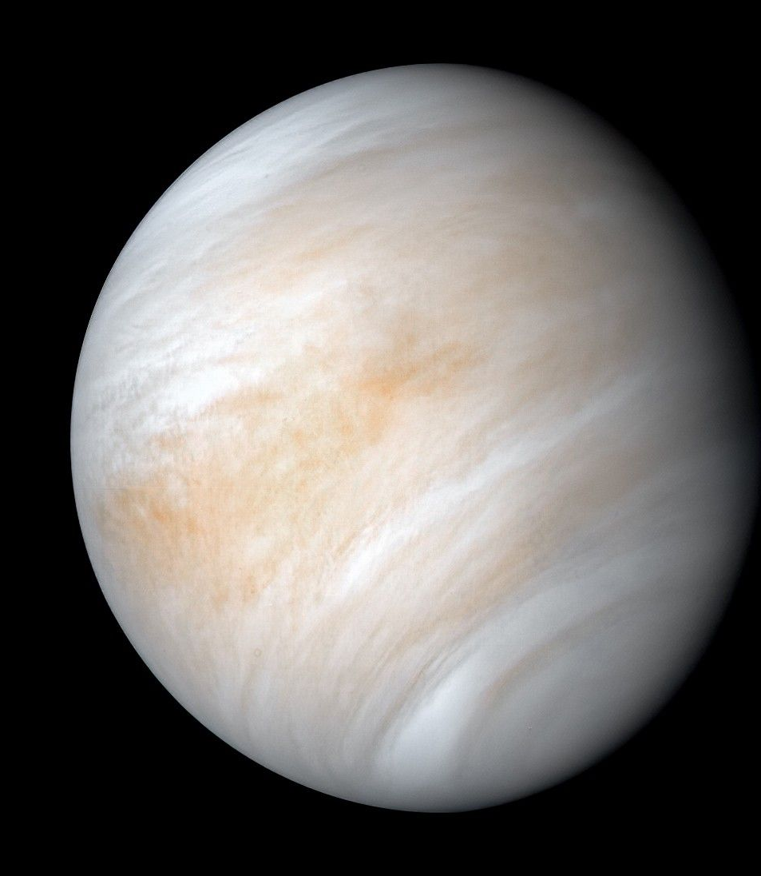
Q1c. Answer
Can you use the following information to estimate the surface temperature of Venus
Radius = 6052 km
Solar constant = 2637 W m²
Albedo = 0.75
T = (((1-albedo) * solar constant) / (4σ))^{1/4}
= ((0.25* 2637) / (4*5.67*10⁻⁸))^{1/4}
= 232 K

Slide 6
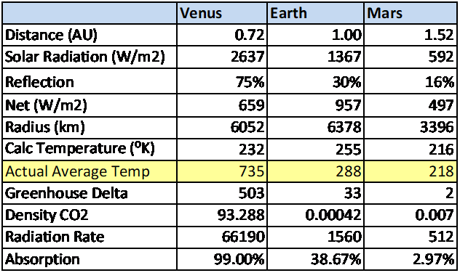
Workshop 1 - Answers
Temperature T_{s} = (Net Solar Flux/(4*Stefan-Boltzmann Constant))^0.25
Mars Atmosphere has a Greenhouse Effect of 2º
Mars atmosphere is very thin, approx. pressure is (approx. 6 mb) than Earth’s (1000 mb)
However, 95% of its atmosphere is CO₂, about 16 times the amount CO₂ in our atmosphere.
Notes:
actual temperature of Mars as measured is 218 K, whereas the calculated temperature is 216. That means it has a greenhouse effect of 2 degrees. Its atmosphere is very thin but has about 16 times the CO2 in our atmosphere. Venus on the other hand has 92 times our atmospheric density, mostly CO2, and is a raging inferno.
1000 mb = 100000 Pascals

Slide 7

Workshop 1 - Answers
Actual temperature of Mars as measured is 218 K, whereas the calculated temperature is 216.
That means it has a greenhouse effect of 2 degrees.
Its atmosphere is very thin but has about 16 times the CO₂ in our atmosphere.
Venus on the other hand has 92 times our atmospheric density, mostly CO₂, and is a hothouse!

Slide 8
Global Climate Change
Week 3 – Questions and Answers
Dr Thomas Bannan
Thomas.Bannan@Manchester.ac.uk
Notes:
Welcome
Individual introductions

Slide 9
Q1.
What is meant by climate change?

Slide 10
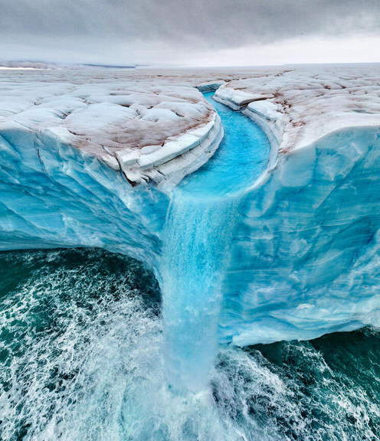
Q1. Answer
Weather is what is happening in the atmosphere at any one time: how warm, windy, sunny or humid it is.
Climate is the description of the average weather we might expect at a given time, usually taken over a 30 year period to average out year to year variability perhaps due to a particularly hot summer or very cold winter, and it also includes information about variability (e.g. what the usual difference is between hot years and cold years) and extremes (e.g. how often an extremely hot day happens).
If the climate is changing, then the 30-year average temperature, or rainfall, etc, is changing.

Slide 11
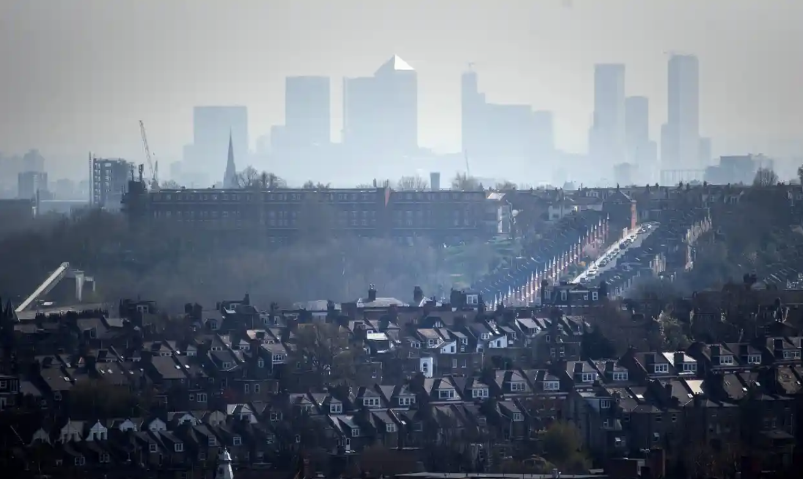
Q2.
Discuss and provide examples of aerosol impacts on air quality and health.

Slide 12
Q2 Answer
Discuss and provide examples of aerosol impacts on air quality and health.
Air Quality
Aerosols contribute significantly to air pollution by increasing the concentration of particulate matter in the atmosphere. These particles originate from sources such as vehicle emissions, industrial activities, and biomass burning. When aerosol levels rise, visibility decreases, and overall air quality deteriorates.
Health
Inhalation of aerosol particles can cause or exacerbate a range of respiratory problems, including asthma, bronchitis, and other chronic lung conditions. The smallest particles can penetrate deep into the lungs and enter the bloodstream, contributing to cardiovascular issues such as heart attacks. Prolonged exposure to high concentrations of particulate matter has also been associated with an increased risk of lung cancer and premature mortality. Vulnerable groups, such as children and the elderly, are especially susceptible to these adverse health effects.

Slide 13
Q3.
Atmospheric particles (aerosols) such as sulfate, nitrate, organic carbon, and black carbon are a major component of air pollution and are linked to adverse human health outcomes. As a result, air-quality regulations around the world aim to reduce particle concentrations, particularly PM2.5. Why might reducing atmospheric particle concentrations lead to clear air-quality benefits but also create climate disbenefits? What effects might this have on the climate system?

Slide 14
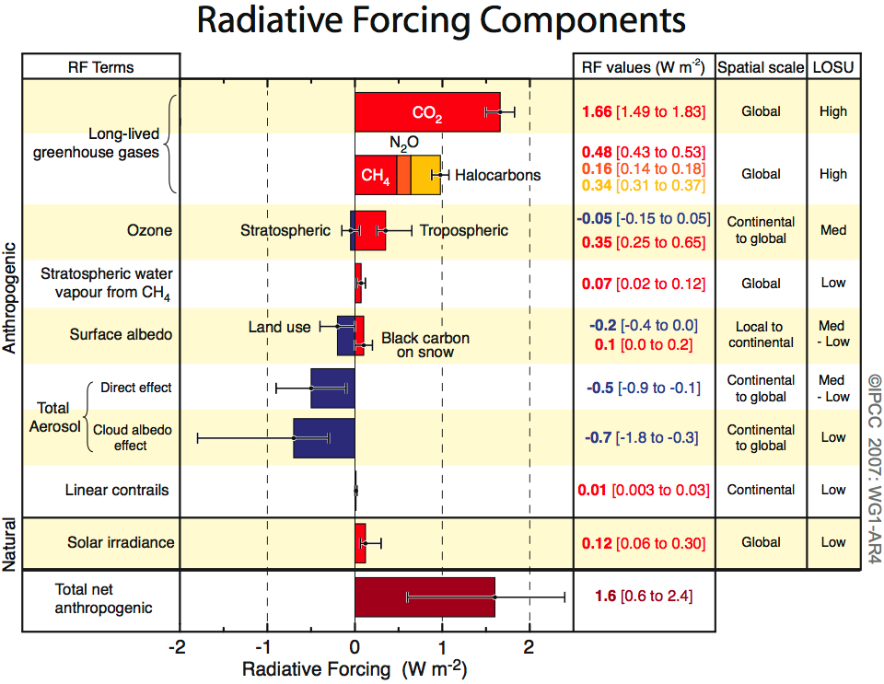
Q3. Answer
Atmospheric particles (aerosols) such as sulfate, nitrate, organic carbon, and black carbon are a major component of air pollution and are linked to adverse human health outcomes. As a result, air-quality regulations around the world aim to reduce particle concentrations, particularly fine particulate matter (PM2.5). Why might reducing atmospheric particle concentrations lead to clear air-quality benefits but also create climate disbenefits? What effects might this have on the climate system?
Many aerosols also play an important role in the climate system. Particles such as sulfate scatter incoming shortwave solar radiation and increase cloud reflectivity, producing a net cooling effect on the climate. This represents a negative radiative forcing that partially offsets the warming caused by long-lived greenhouse gases such as carbon dioxide as is shown in the figure to the right.
When aerosol concentrations are reduced, this cooling effect is weakened. As a result, more solar radiation reaches the Earth’s surface, leading to a positive change in the radiation balance and an increase in surface temperature. This warming can occur relatively quickly because aerosols have short atmospheric lifetimes (days to weeks), meaning the climate system responds rapidly once emissions are reduced.
This creates a climate “disbenefit” in the short term: although air quality improves, the removal of aerosols reveals previously masked greenhouse-gas-driven warming.
Overall, this example highlights the complex relationship between air-quality policy and climate change. While aerosol reductions are essential for protecting human health, they need to be accompanied by rapid reductions in greenhouse gas emissions to avoid additional warming.

Slide 15
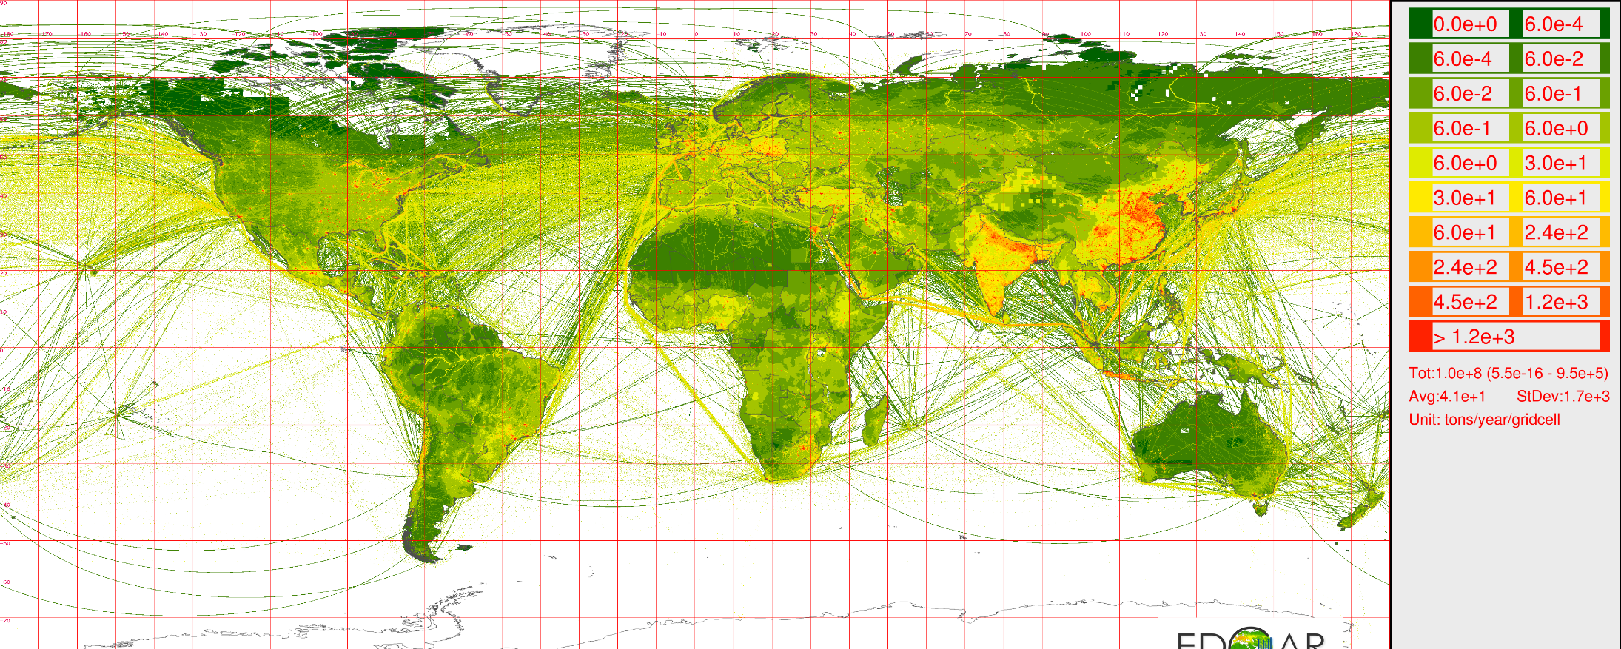
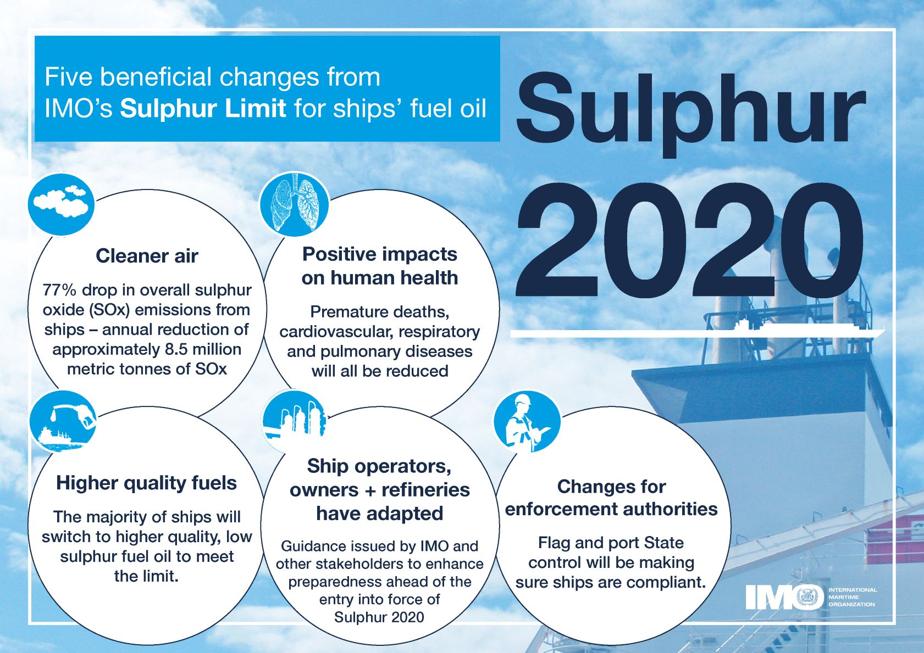
Q4.
Sulfate aerosols originates from atmospheric oxidation of SO₂. This is a global picture of SO₂ emissions. Recently new legislation was passed to reduce SO₂ emissions from shipping.
What impact might this have? What could the unintended consequences of this be? It is worth improving air quality over the ocean?

Slide 16
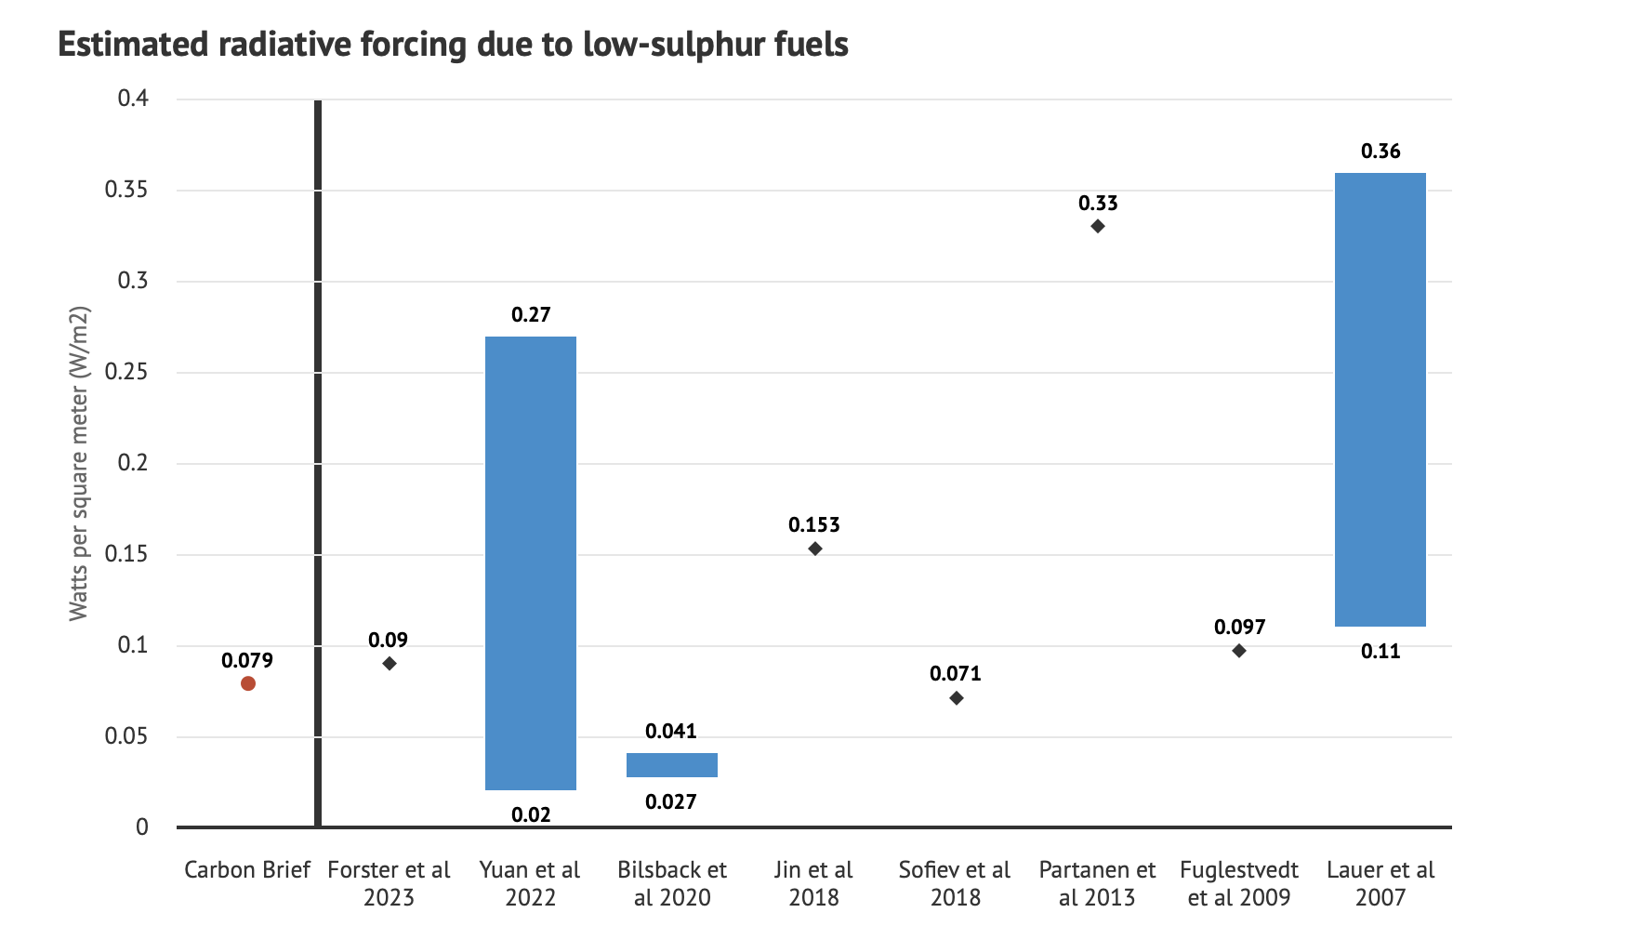
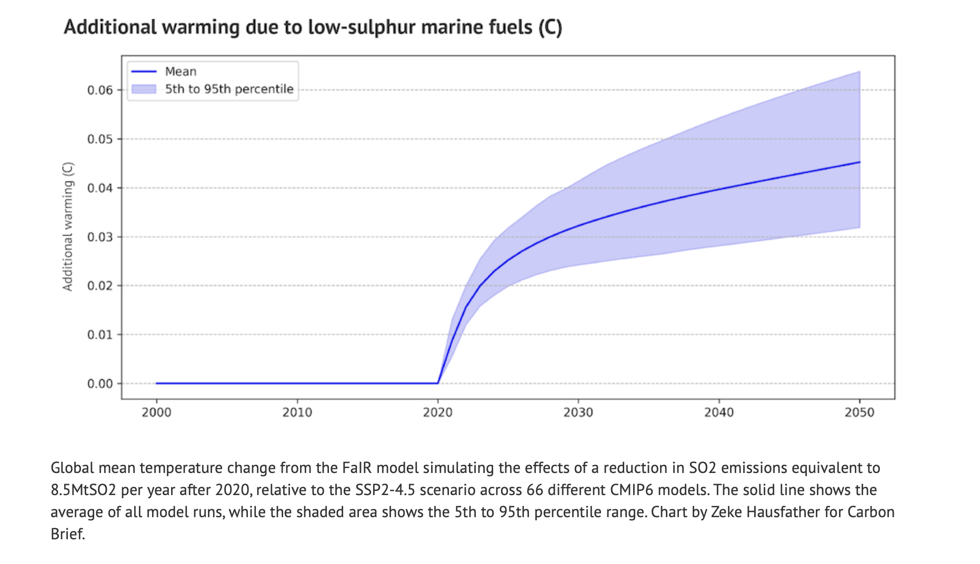
Q4. Answer
This is a global picture of SO₂ emissions. Recently new legislation was passed to reduce SO₂ emissions from shipping fuel.
What impact might this have? What could the unintended consequences of this be?

Slide 17
Q5.
Ozone absorbs both UV and IR radiation. What is the effect on the environment of each?
How would the climate differ if the IR absorption band of ozone didn’t exist?

Slide 18
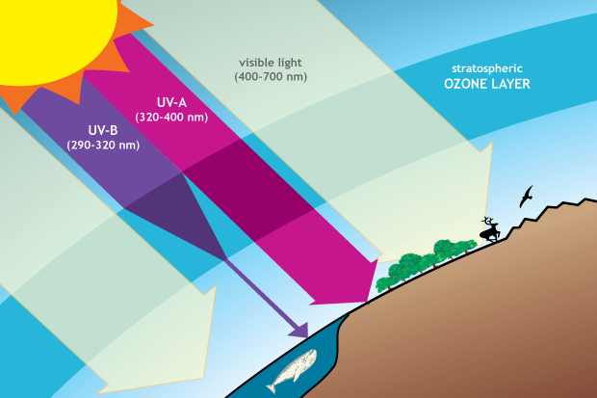
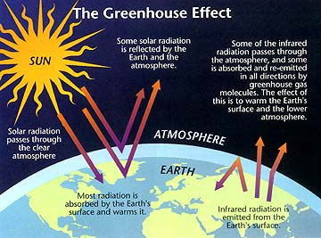
Q5. Answer
Ozone absorbs both UV and IR radiation. What is the effect on the environment of each?
How would the climate differ if the IR absorption band of ozone didn’t exist?
Ozone protects life by absorbing harmful UV radiation in the stratosphere and warms the atmosphere by absorbing outgoing IR radiation. This dual role helps maintain the planet’s temperature balance.
Without IR absorption at ~9600 nm, less heat would be trapped, leading to a cooler atmosphere and surface. The greenhouse effect would weaken, lowering global temperatures.

Slide 19
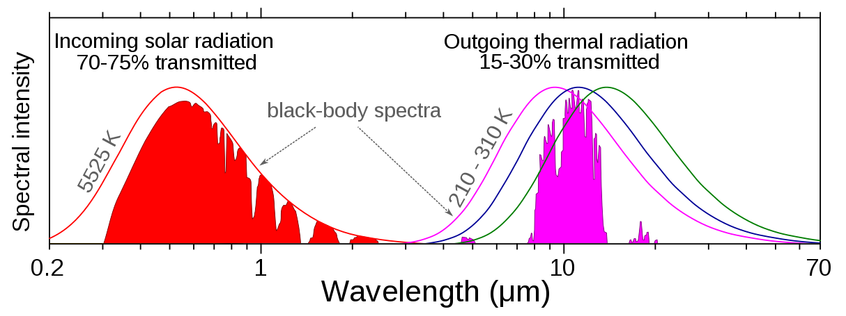
Q6.
Can you use the graph below to estimate the surface temperature of the sun?

Slide 20
Q6. Answer
Can you use the graph below to estimate the surface temperature of the sun?
Wien’s Law:
λ_{max}T = 2.897 x 10⁶
T = 2.897 x 10⁶ / 500 nm
T = 5800 K

Slide 21
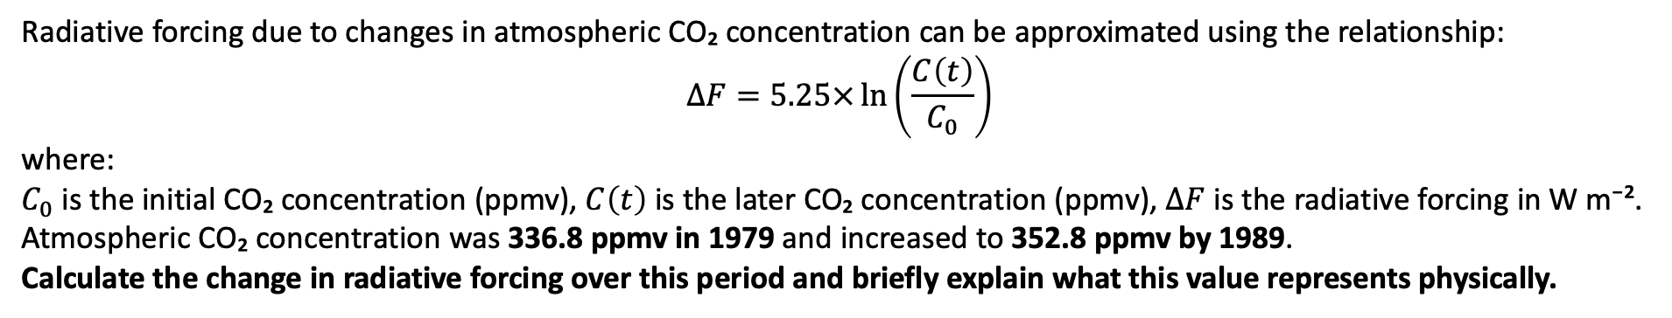
Q7.
Radiative forcing due to changes in atmospheric CO₂ concentration can be approximated using the relationship:
$$ΔF=5.25×\ln\left(\frac{C\left(t\right)}{C_{0}}\right)$$
where:
$C_{0}$ is the initial CO₂ concentration (ppmv), $C\left(t\right)$ is the later CO₂ concentration (ppmv), $ΔF$ is the radiative forcing in W m⁻².
Atmospheric CO₂ concentration was 336.8 ppmv in 1979 and increased to 352.8 ppmv by 1989.
Calculate the change in radiative forcing over this period and briefly explain what this value represents physically.

Slide 22
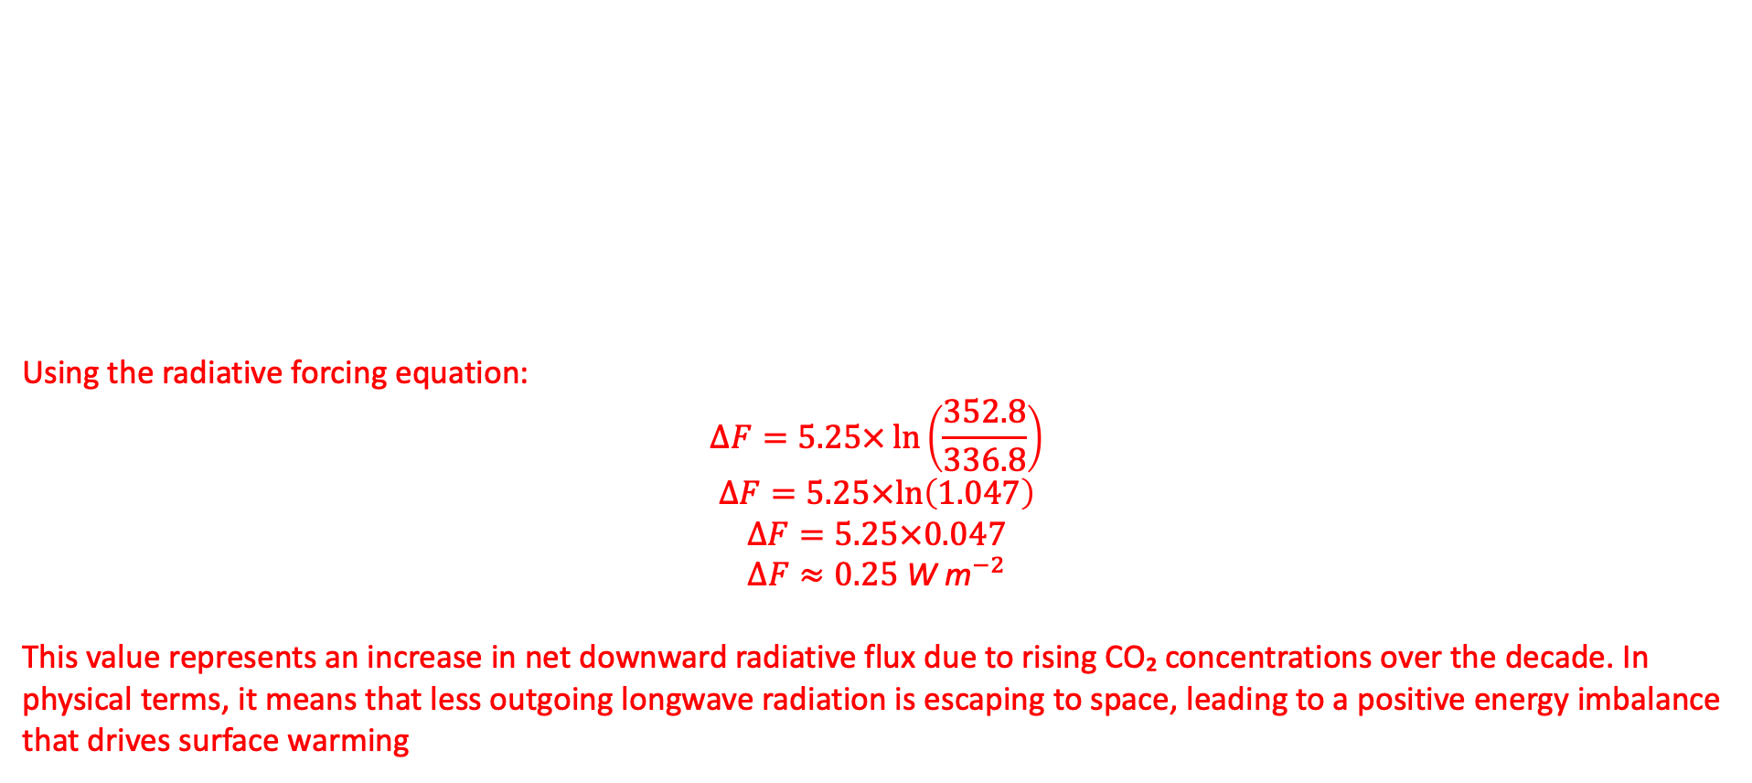
Q7. Answer
Radiative forcing due to changes in atmospheric CO₂ concentration can be approximated using the relationship:
$$ΔF=5.25×\ln\left(\frac{C\left(t\right)}{C_{0}}\right)$$
where:
$C_{0}$ is the initial CO₂ concentration (ppmv), $C\left(t\right)$ is the later CO₂ concentration (ppmv), $ΔF$ is the radiative forcing in W m⁻².
Atmospheric CO₂ concentration was 336.8 ppmv in 1979 and increased to 352.8 ppmv by 1989.
Calculate the change in radiative forcing over this period and briefly explain what this value represents physically.
Using the radiative forcing equation:
$$ΔF=5.25×\ln\left(\frac{352.8}{336.8}\right)$$
$$ΔF=5.25×ln⁡\left(1.047\right)$$
$$ΔF=5.25×0.047$$
$$ΔF≈0.25 {\text{W} \text{m}}^{−2}$$
This value represents an increase in net downward radiative flux due to rising CO₂ concentrations over the decade. In physical terms, it means that less outgoing longwave radiation is escaping to space, leading to a positive energy imbalance that drives surface warming

Slide 23
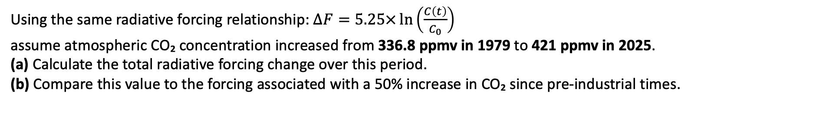
Q8.
Using the same radiative forcing relationship: $ΔF=5.25×\ln\left(\frac{C\left(t\right)}{C_{0}}\right)$
assume atmospheric CO₂ concentration increased from 336.8 ppmv in 1979 to 421 ppmv in 2025.
(a) Calculate the total radiative forcing change over this period.
(b) Compare this value to the forcing associated with a 50% increase in CO₂ since pre-industrial times.
Notes:
(

Slide 24
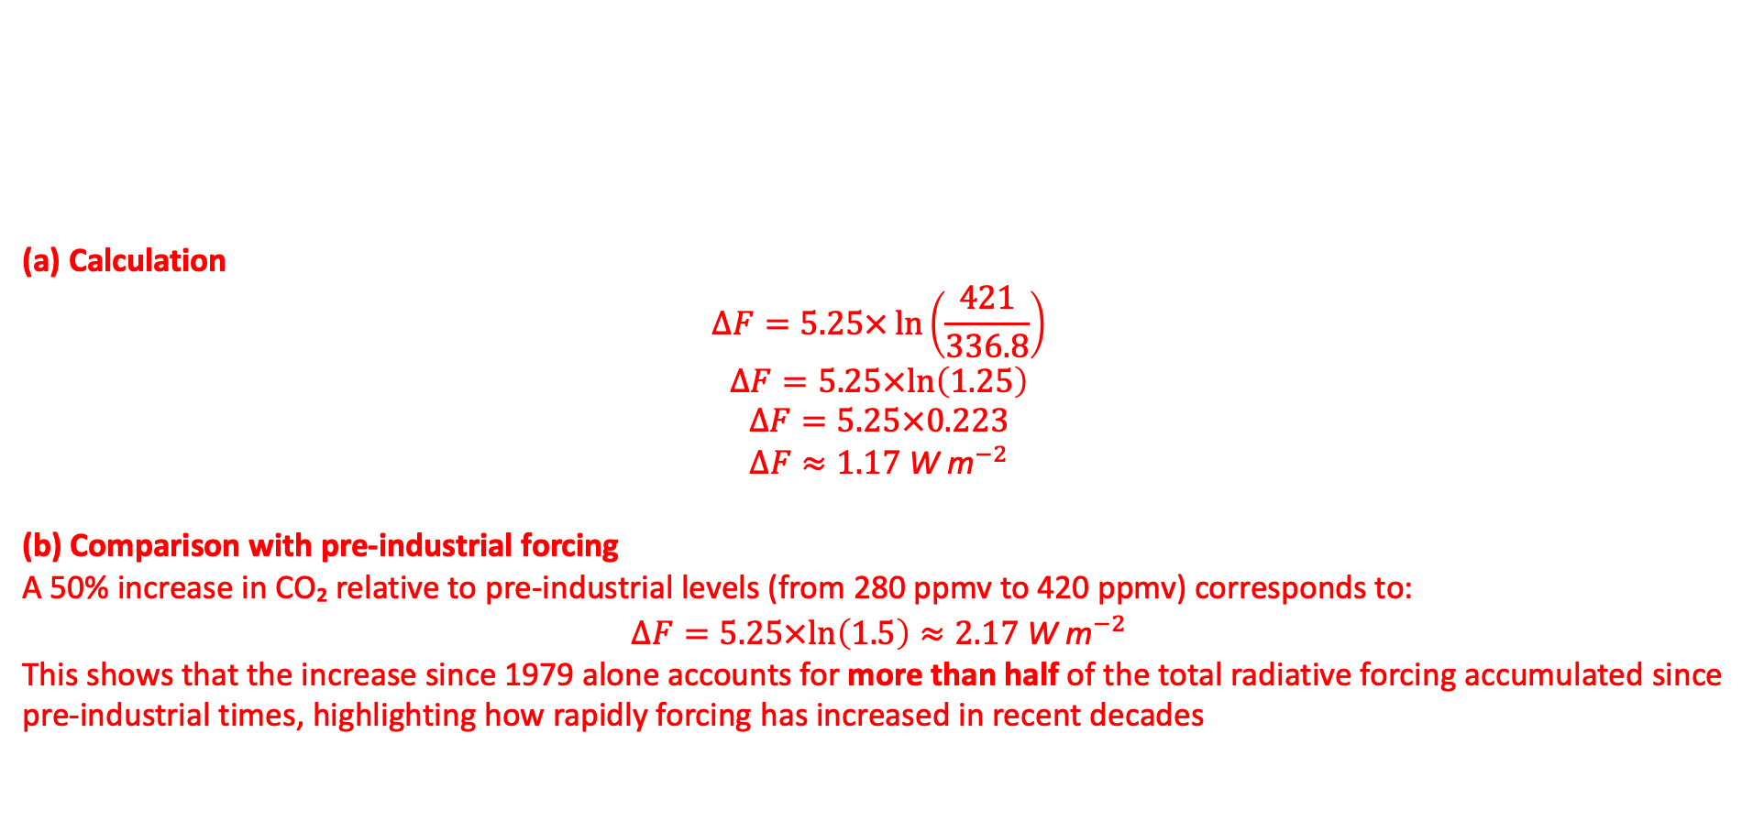
Q8. Answer
Using the same radiative forcing relationship: $ΔF=5.25×\ln\left(\frac{C\left(t\right)}{C_{0}}\right)$
assume atmospheric CO₂ concentration increased from 336.8 ppmv in 1979 to 421 ppmv in 2025.
(a) Calculate the total radiative forcing change over this period.
(b) Compare this value to the forcing associated with a 50% increase in CO₂ since pre-industrial times.
(a) Calculation
$$ΔF=5.25×\ln\left(\frac{421}{336.8}\right)$$
$$ΔF=5.25×ln⁡\left(1.25\right)$$
$$ΔF=5.25×0.223$$
$$ΔF≈1.17 {\text{W} \text{m}}^{−2}$$
(b) Comparison with pre-industrial forcing
A 50% increase in CO₂ relative to pre-industrial levels (from 280 ppmv to 420 ppmv) corresponds to:
$$ΔF=5.25×ln⁡\left(1.5\right)≈2.17 {\text{W} \text{m}}^{−2}$$
This shows that the increase since 1979 alone accounts for more than half of the total radiative forcing accumulated since pre-industrial times, highlighting how rapidly forcing has increased in recent decades

Slide 25
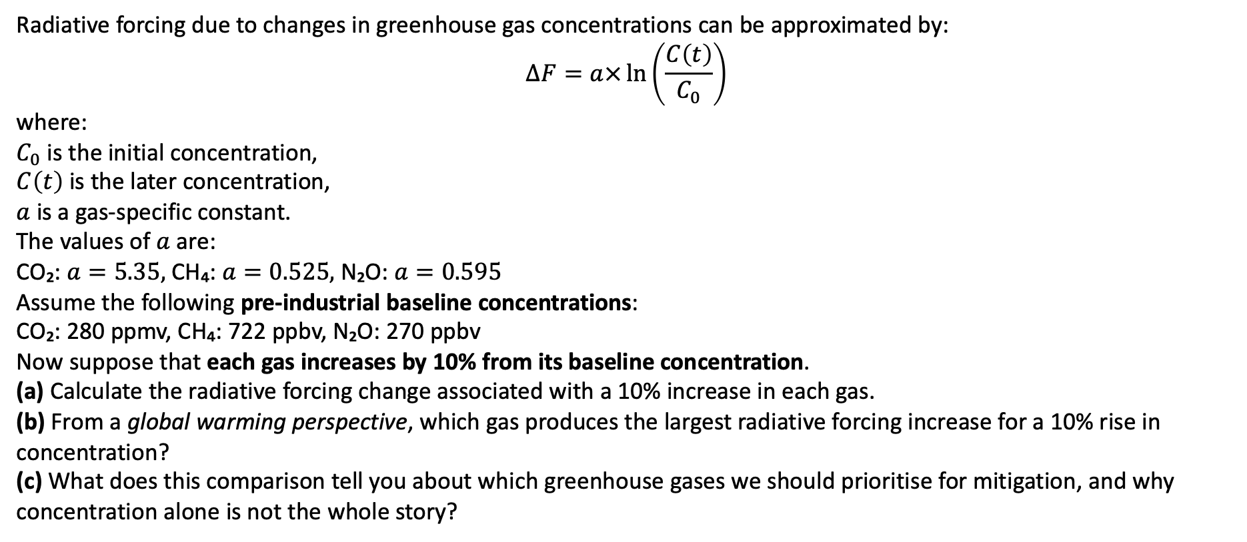
Q9.
Radiative forcing due to changes in greenhouse gas concentrations can be approximated by:
$$ΔF=a×\ln\left(\frac{C\left(t\right)}{C_{0}}\right)$$
where:
$C_{0}$ is the initial concentration,
$C\left(t\right)$ is the later concentration,
$a$ is a gas-specific constant.
The values of $a$ are:
CO₂: $a=5.35,$CH₄: $a=0.525,$N₂O: $a=0.595$
Assume the following pre-industrial baseline concentrations:
CO₂: 280 ppmv, CH₄: 722 ppbv, N₂O: 270 ppbv
Now suppose that each gas increases by 10% from its baseline concentration.
(a) Calculate the radiative forcing change associated with a 10% increase in each gas.
(b) From a global warming perspective, which gas produces the largest radiative forcing increase for a 10% rise in concentration?
(c) What does this comparison tell you about which greenhouse gases we should prioritise for mitigation, and why concentration alone is not the whole story?

Slide 26
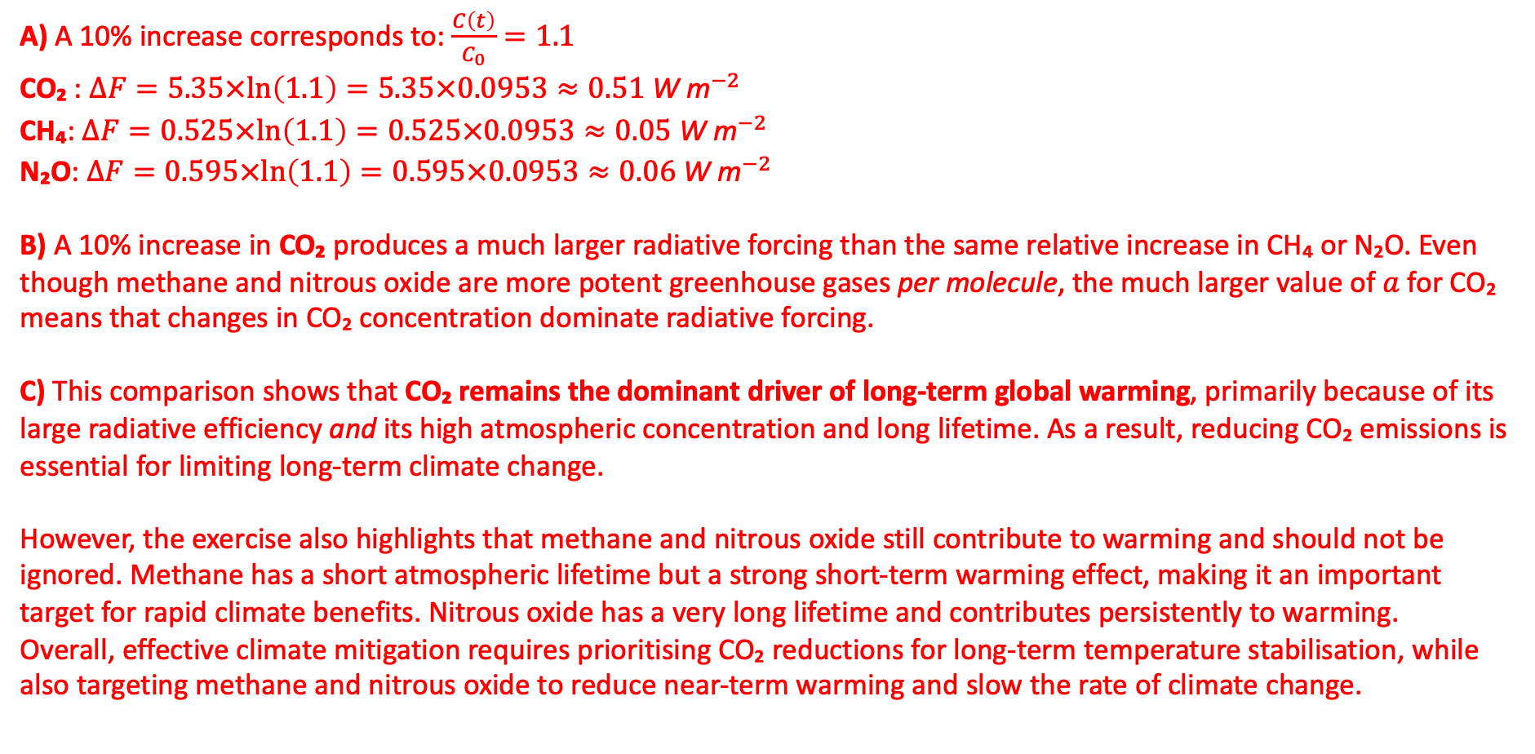
Q9. Answer
A) A 10% increase corresponds to: $\frac{C\left(t\right)}{C_{0}}=1.1$
CO₂ : $ΔF=5.35×ln⁡\left(1.1\right)=5.35×0.0953≈0.51 {\text{W} \text{m}}^{−2}$
CH₄: $ΔF=0.525×ln⁡\left(1.1\right)=0.525×0.0953≈0.05 {\text{W} \text{m}}^{−2}$
N₂O: $ΔF=0.595×ln⁡\left(1.1\right)=0.595×0.0953≈0.06 {\text{W} \text{m}}^{−2}$
B) A 10% increase in CO₂ produces a much larger radiative forcing than the same relative increase in CH₄ or N₂O. Even though methane and nitrous oxide are more potent greenhouse gases per molecule, the much larger value of $a$ for CO₂ means that changes in CO₂ concentration dominate radiative forcing.
C) This comparison shows that CO₂ remains the dominant driver of long-term global warming, primarily because of its large radiative efficiency and its high atmospheric concentration and long lifetime. As a result, reducing CO₂ emissions is essential for limiting long-term climate change.
However, the exercise also highlights that methane and nitrous oxide still contribute to warming and should not be ignored. Methane has a short atmospheric lifetime but a strong short-term warming effect, making it an important target for rapid climate benefits. Nitrous oxide has a very long lifetime and contributes persistently to warming.
Overall, effective climate mitigation requires prioritising CO₂ reductions for long-term temperature stabilisation, while also targeting methane and nitrous oxide to reduce near-term warming and slow the rate of climate change.

